Slide 1
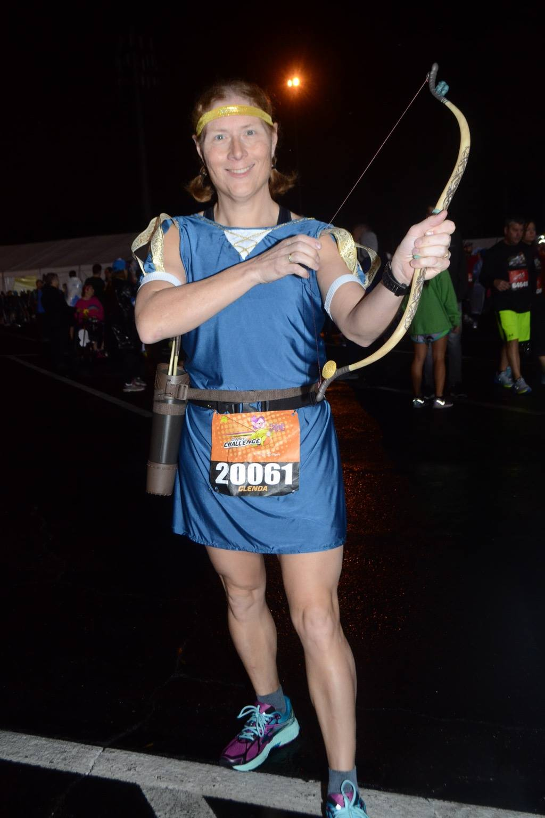
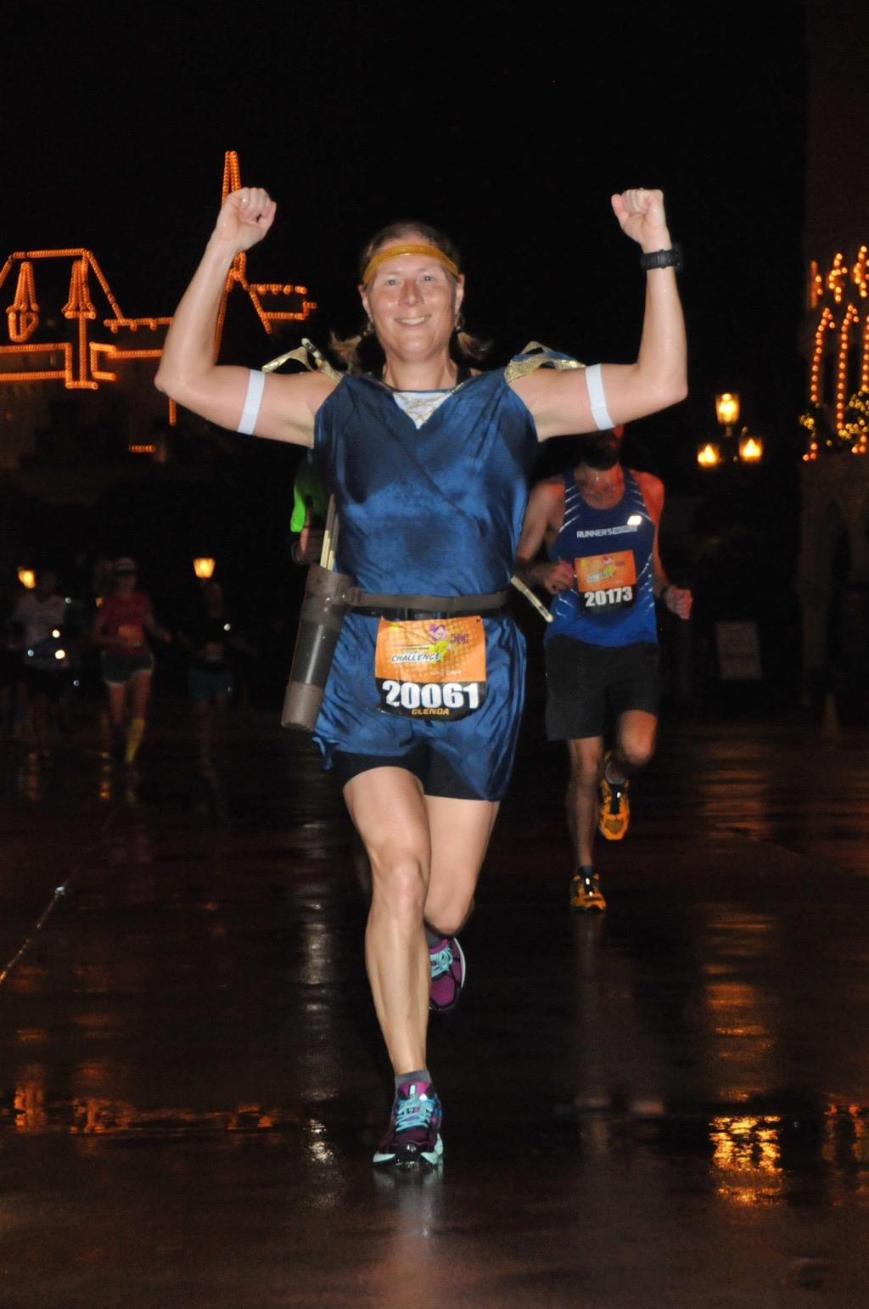
Making Play of Serious Recreational Athletics Through the Use of Costume
Reclaiming the Joy:

Slide 2
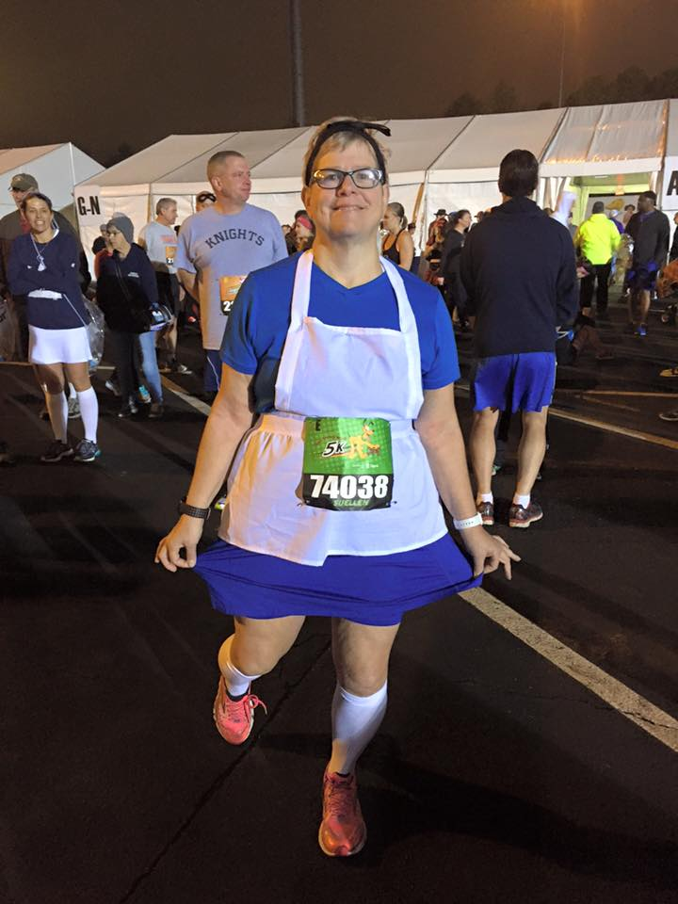
Suellen Adams, adjunct professor of Library and Information Studies

Slide 3
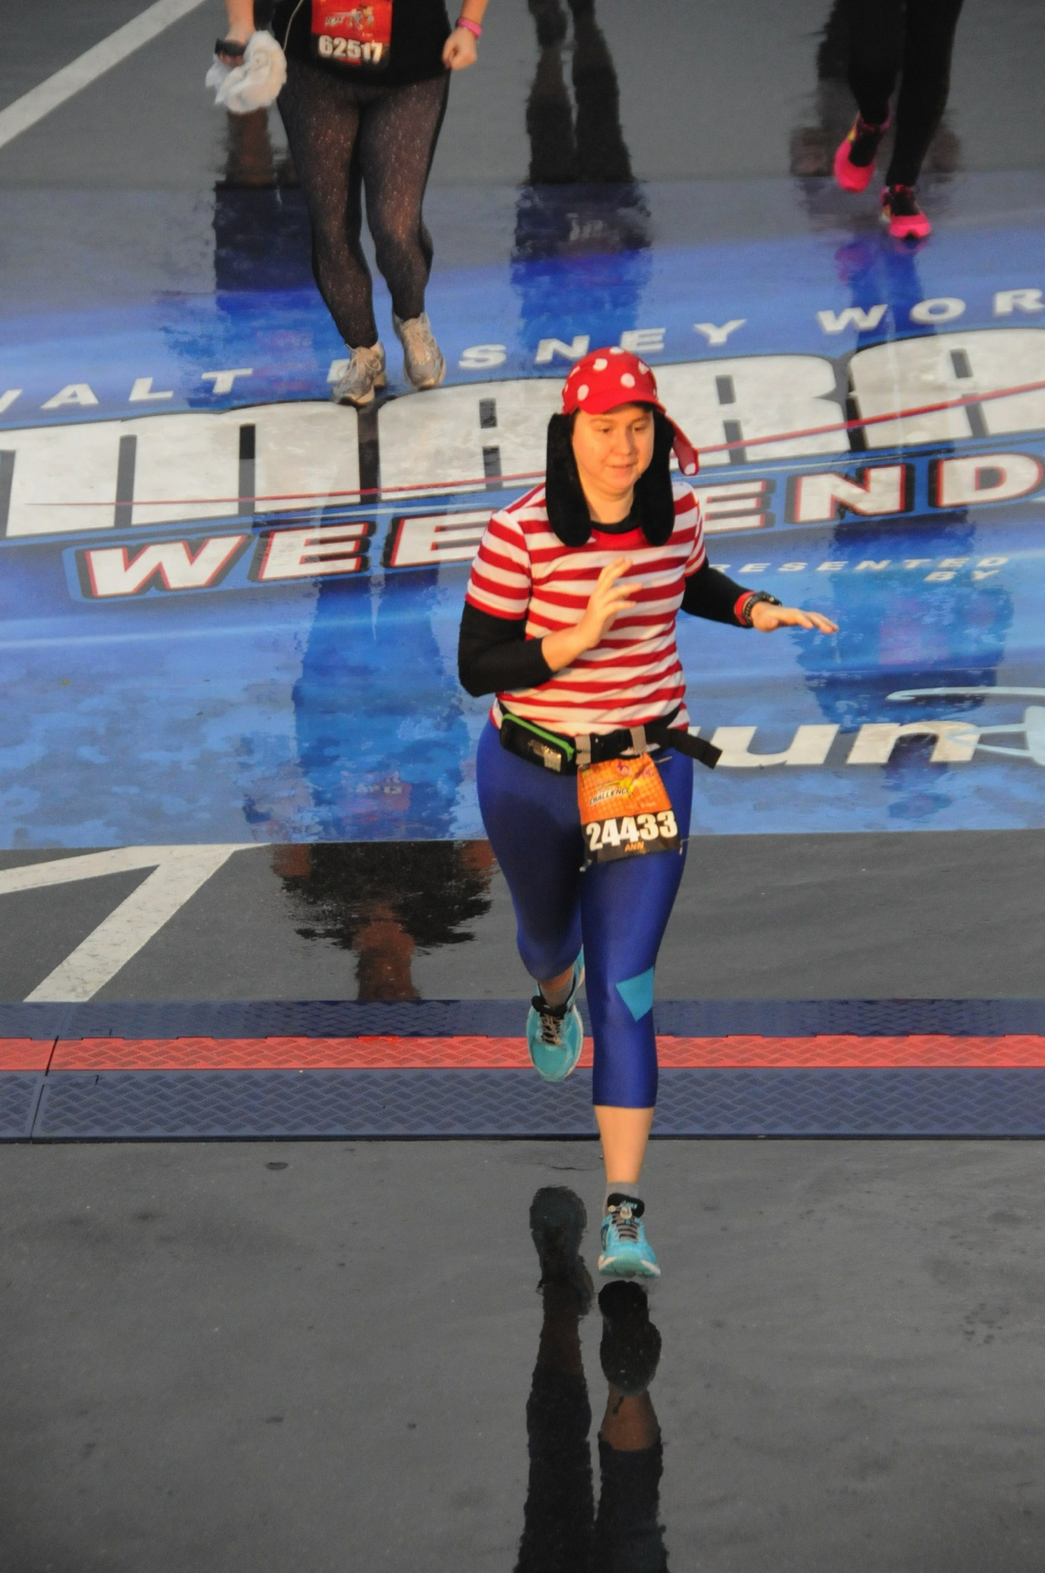
Some background—
Started with a SurveyMonkey survey distributed primarily on social media groups for running and racing in costume.
207 responses.
Approximately half agreed to be interviewed via e-mail
About half of those subsequently contacted with the interview responded within the time frame stated

Slide 4
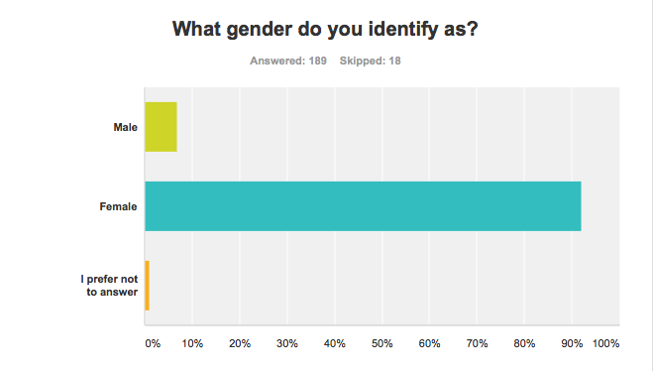
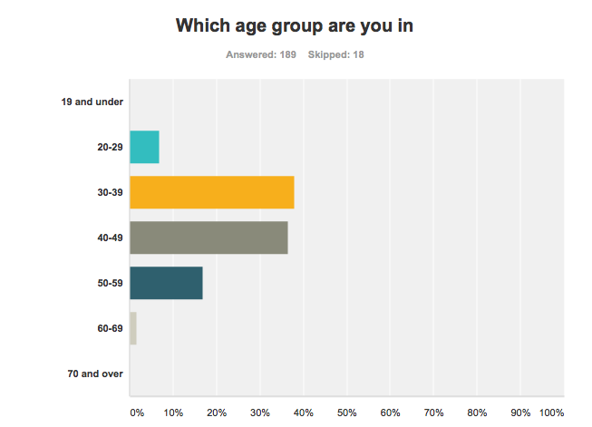
92% of the respondents identified as female
Almost 75% were between 30 and 49 years of age

Slide 5
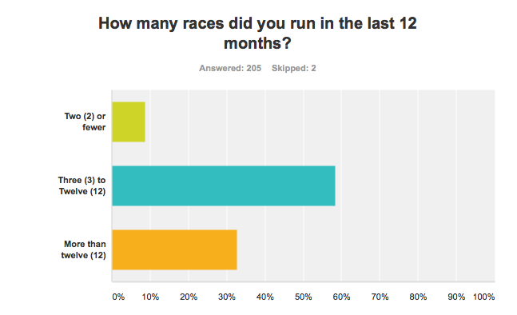
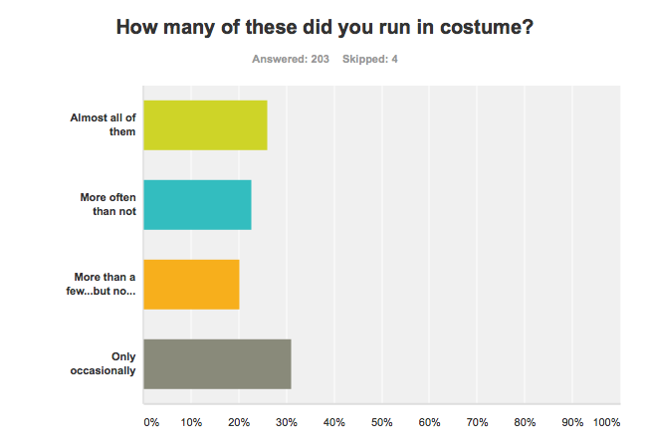
These were relatively prolific racers, almost all of them raced at least 3 times a year and almost a third raced more than once a month
But they didn’t always race in costume, about half raced in costume much of the time, while half did so more rarely

Slide 6
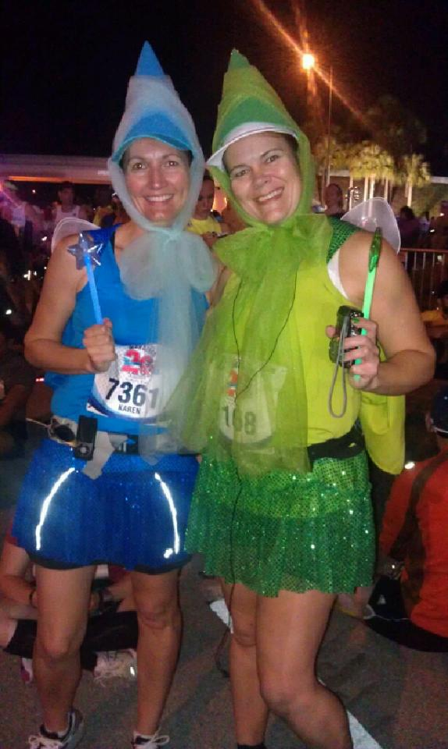
Besides basic demographics respondents were asked some basic questions about how they created their costumes and what was important in their choices.

Slide 7
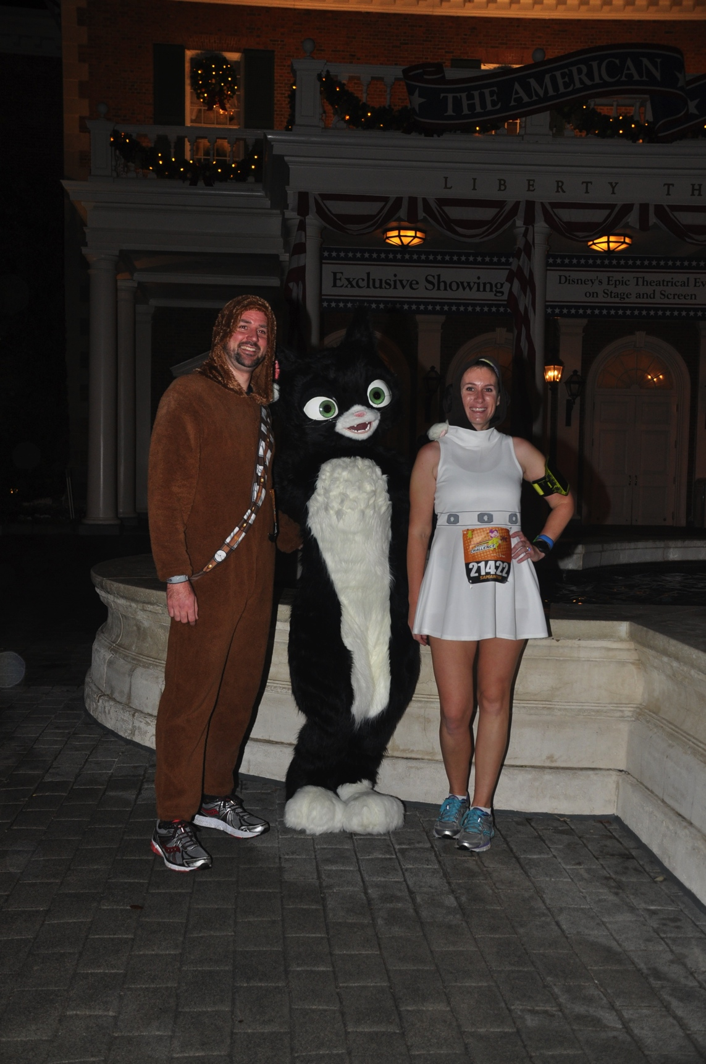
The interview asked –
How they began running in costume.
What kind of a runner they were.
Specifics about costume creation, both individual and in groups.
What was hard and easy about costume running.
Any further comments.
They were also asked if they were willing to share photos…and many of them did.

Slide 8
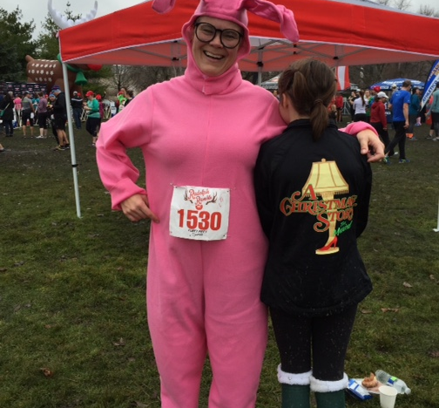
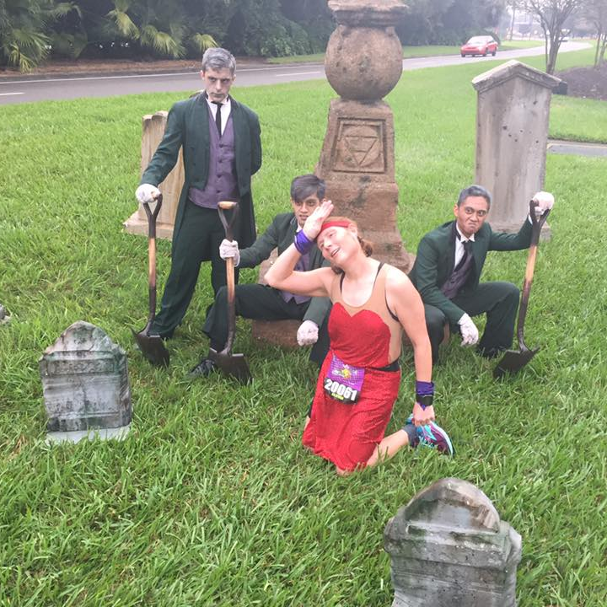
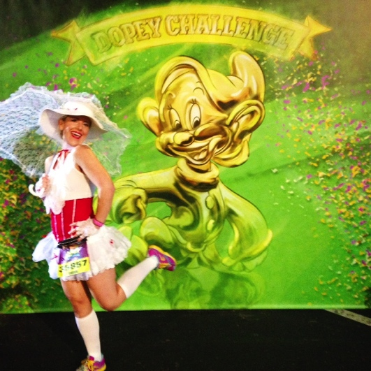
Playfulness
…manifest joy and sense of humor

Slide 9
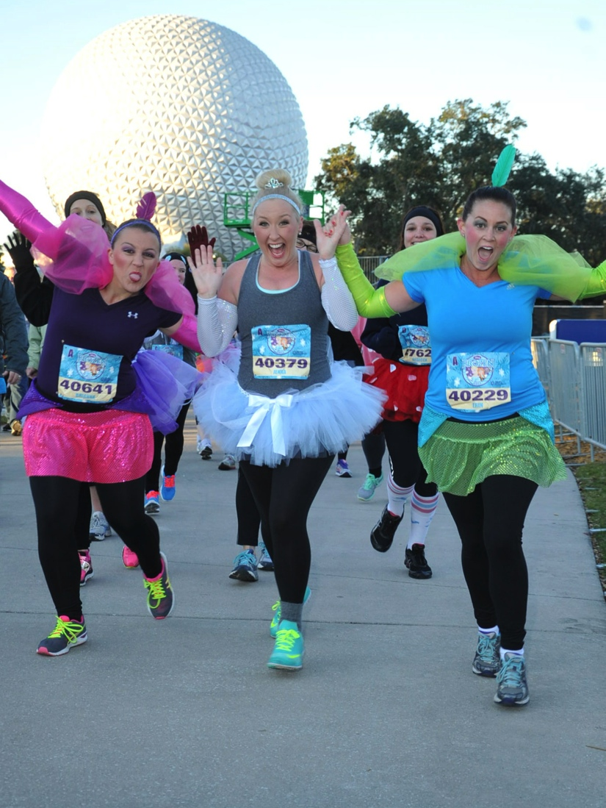
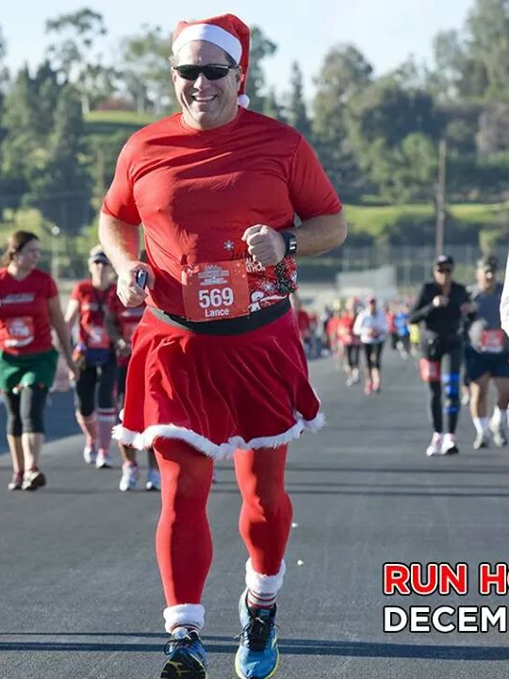
Manifest Joy
Sense of Humor (Gelotophilia)

Slide 10
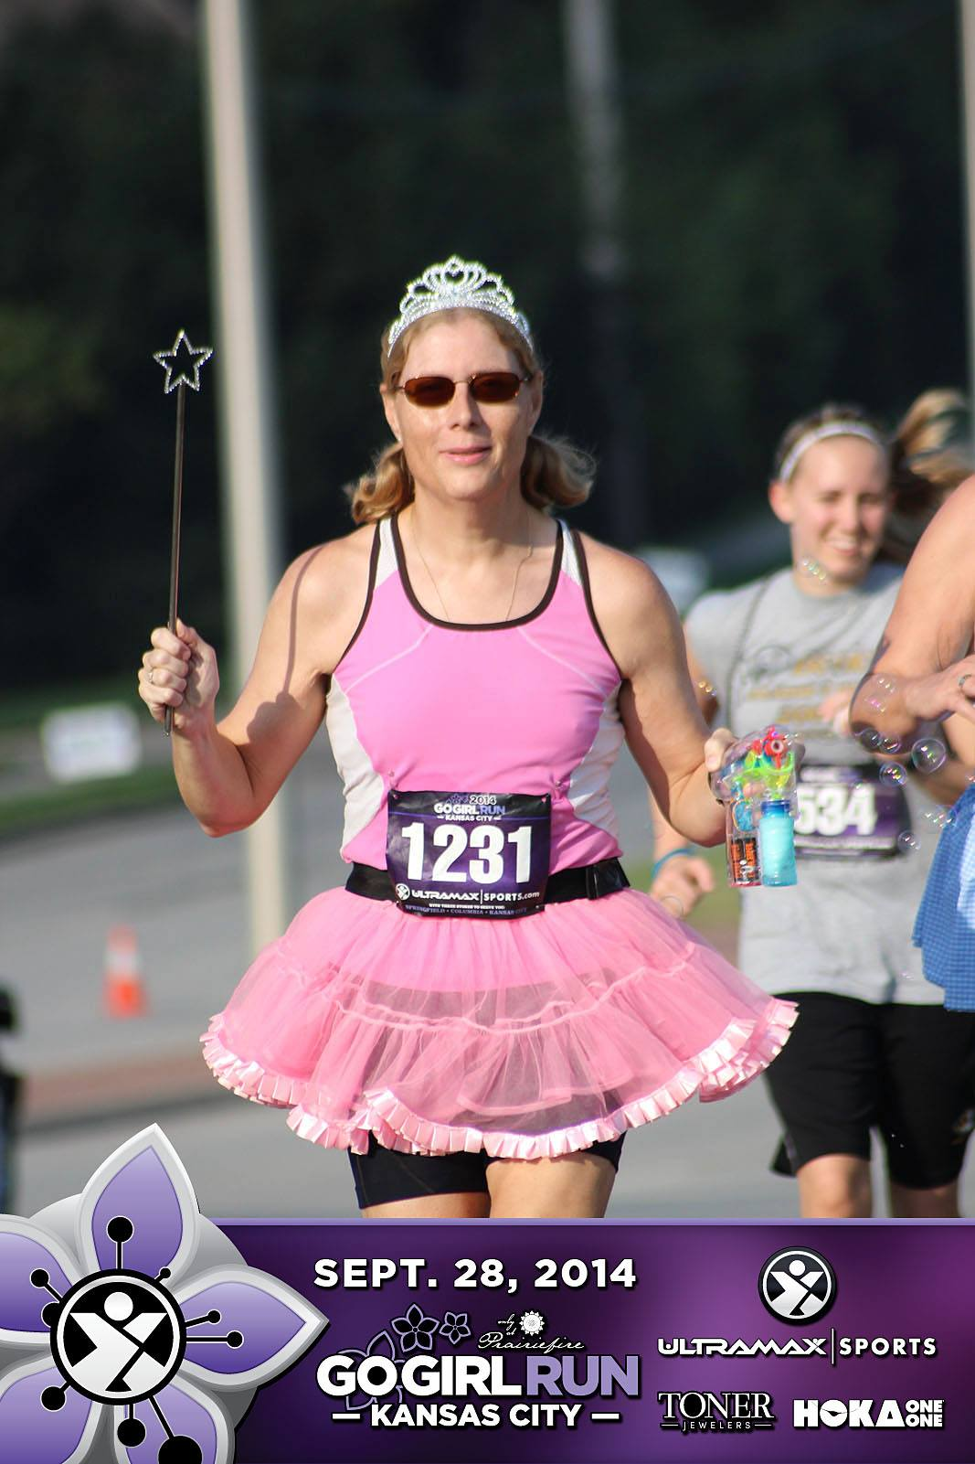
“Let's be honest. How often do you get to wear a tiara? It's fun to dress up!”
---
“And I confess it is quite a thrill to pass a guy in spandex who is being super serious in a race when you look ridiculous. A reminder that races are fun.”
--
“I absolutely get enjoyment out of it, plenty of great memories”

Slide 11
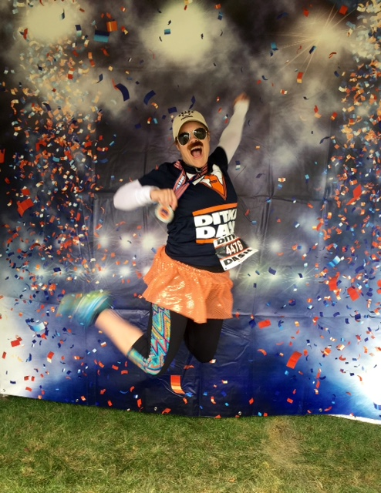
“Costumes add and extra element of fun to the race. They help create amazing memories and great photos”
--
“IT KEEPS YOU YOUNG!! 😄”
--
“The event pics are priceless! It makes me happy. The shout outs you get from fellow runners. It puts a smile on their faces (even if they think you're crazy!)”

Slide 12
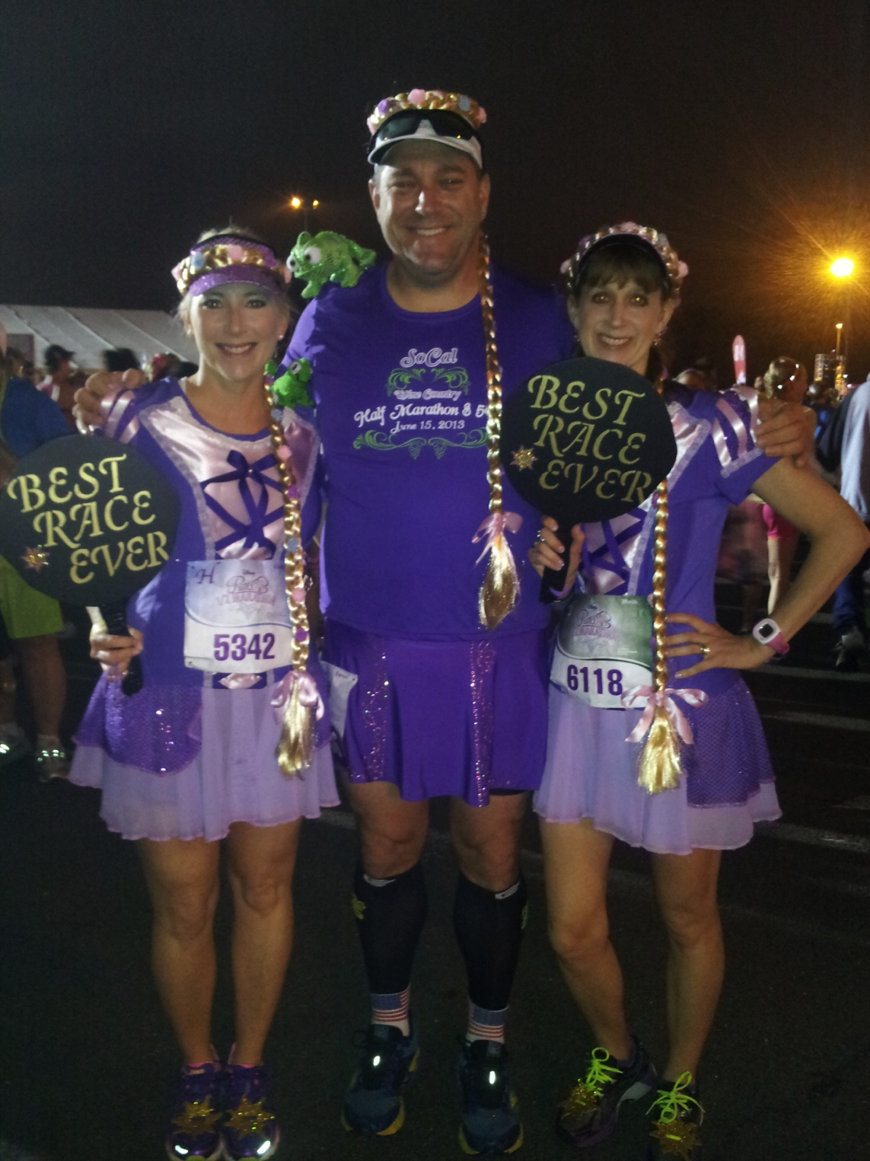
“I like the ones that have the best laugh factor. One that got a huge response was when I dressed up in a clown suit for the last 25 miles of a 100 mile trail race”
--
“What is the best part about running in costume? Making people laugh.”

Slide 13
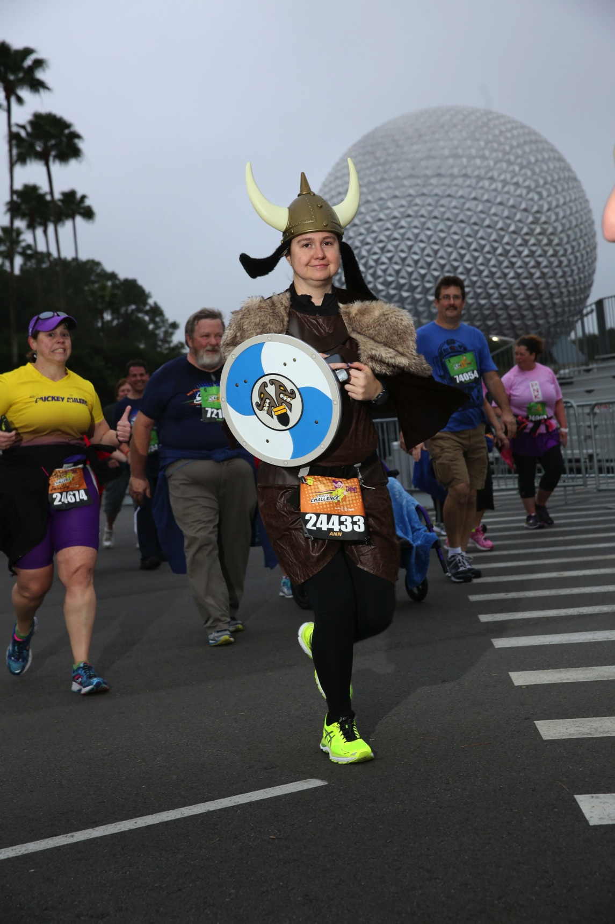
“My motto is “Spreading smiles for miles!” I’m definitely not a fast runner, but I make people smile and it’s a great conversation starter.”
--
“Making people smile . Often people are nervous or anxious at a race , it makes some smile or laugh”

Slide 14
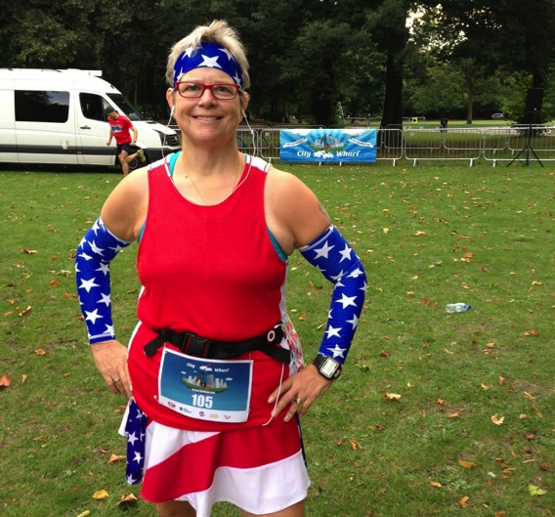
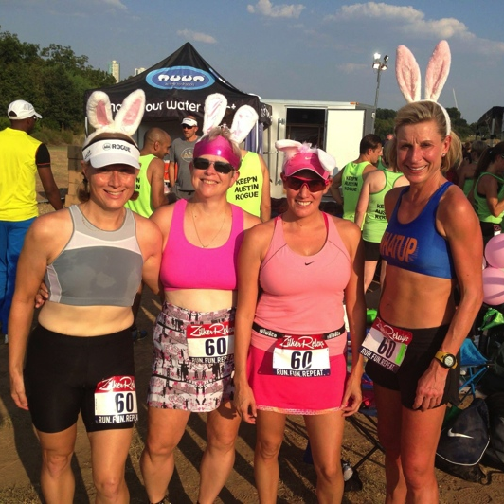
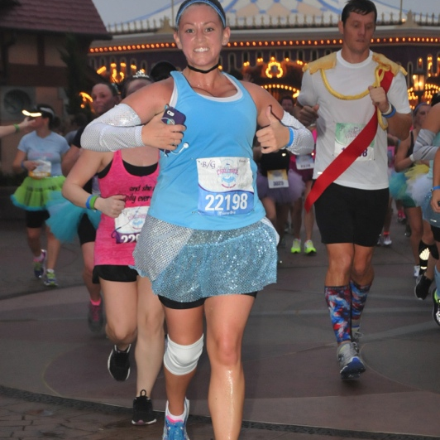
But not forgetting the functions of racing..

Slide 15
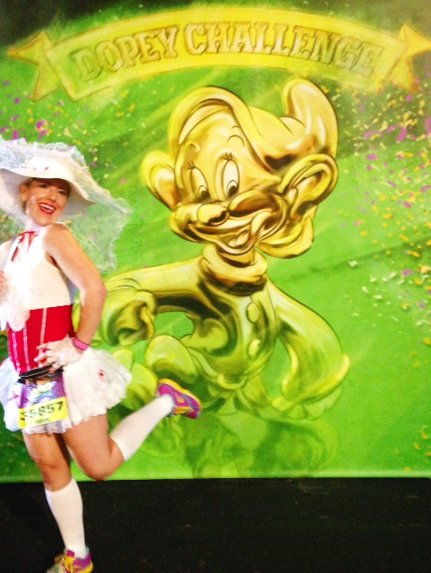
“For all my costumes, I try and use and embellish actual running clothes to make them as comfortable and practical as possible. For the Starbucks Red Cup costume, it was pretty basic; red running shirt, red skirt, and a cardboard “sleeve” around my waist. I used an actual lid with a straw and attached it to a headband. For Mary Poppins, I wanted to include as many details as possible and still make it functional.”

Slide 16
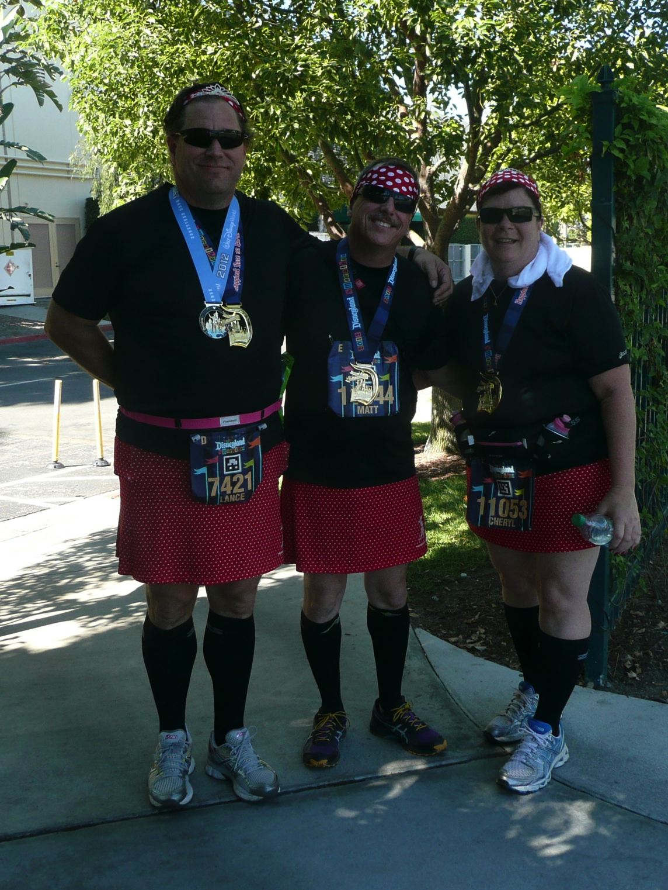
“Making it practical and functional. I started off running mostly 5k’s with an occasional 10K. I now mostly run half and full marathons, but still love to dress up. Being a little uncomfortable is ok for 3 miles, but not for 26“
--
“I do try to design the costume so that it doesn’t impact my running at all.

Slide 17
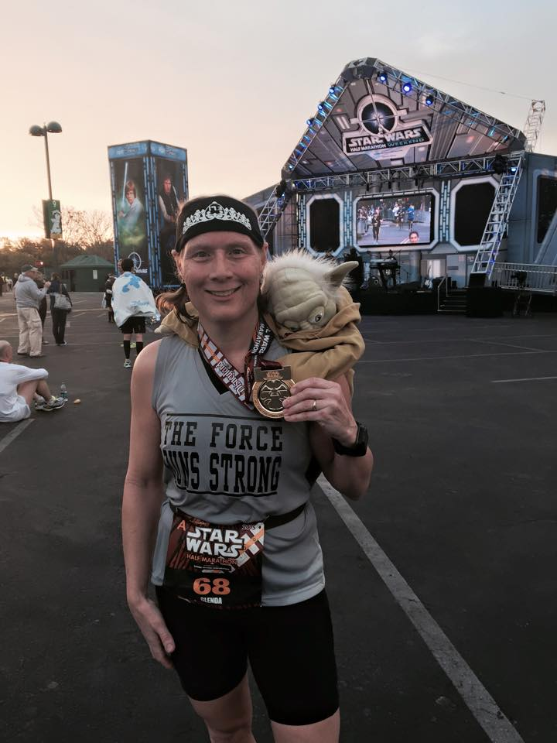
“Walking to the start line too because sometimes people treat you like you don't belong at a race because you are in costume. Especially true in races where you are designated a start time and show up in costume. Some seem to think because you are in a costume you can't be fast or a serious runner--but I can be all business when needed in that costume”

Slide 18
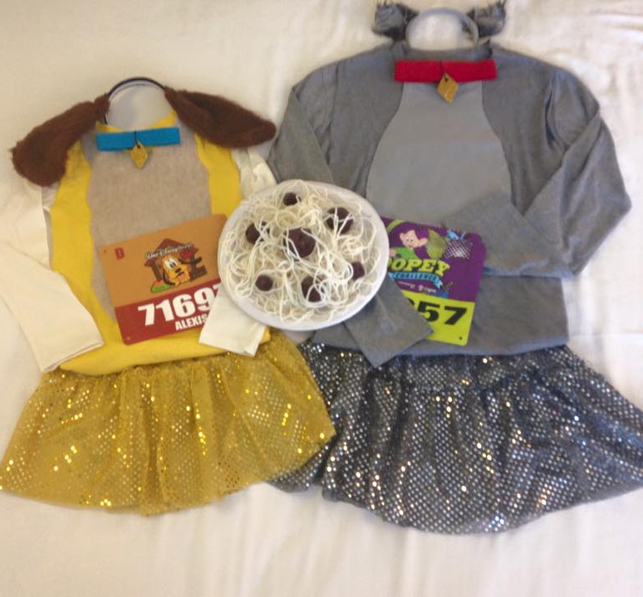
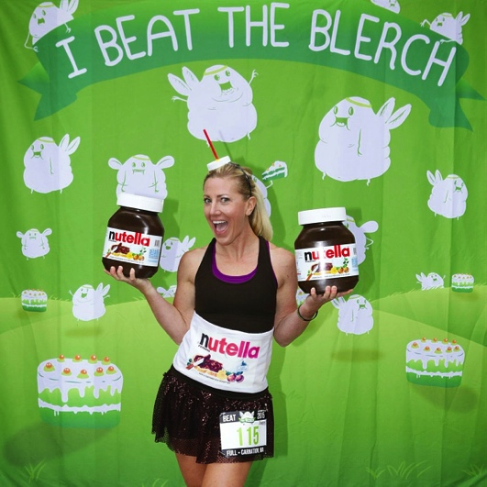
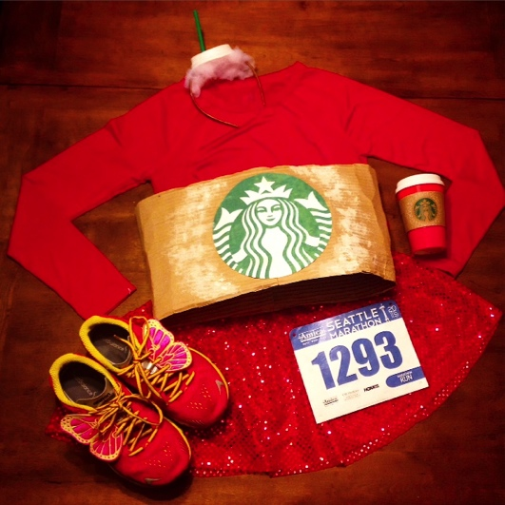
Creativity

Slide 19
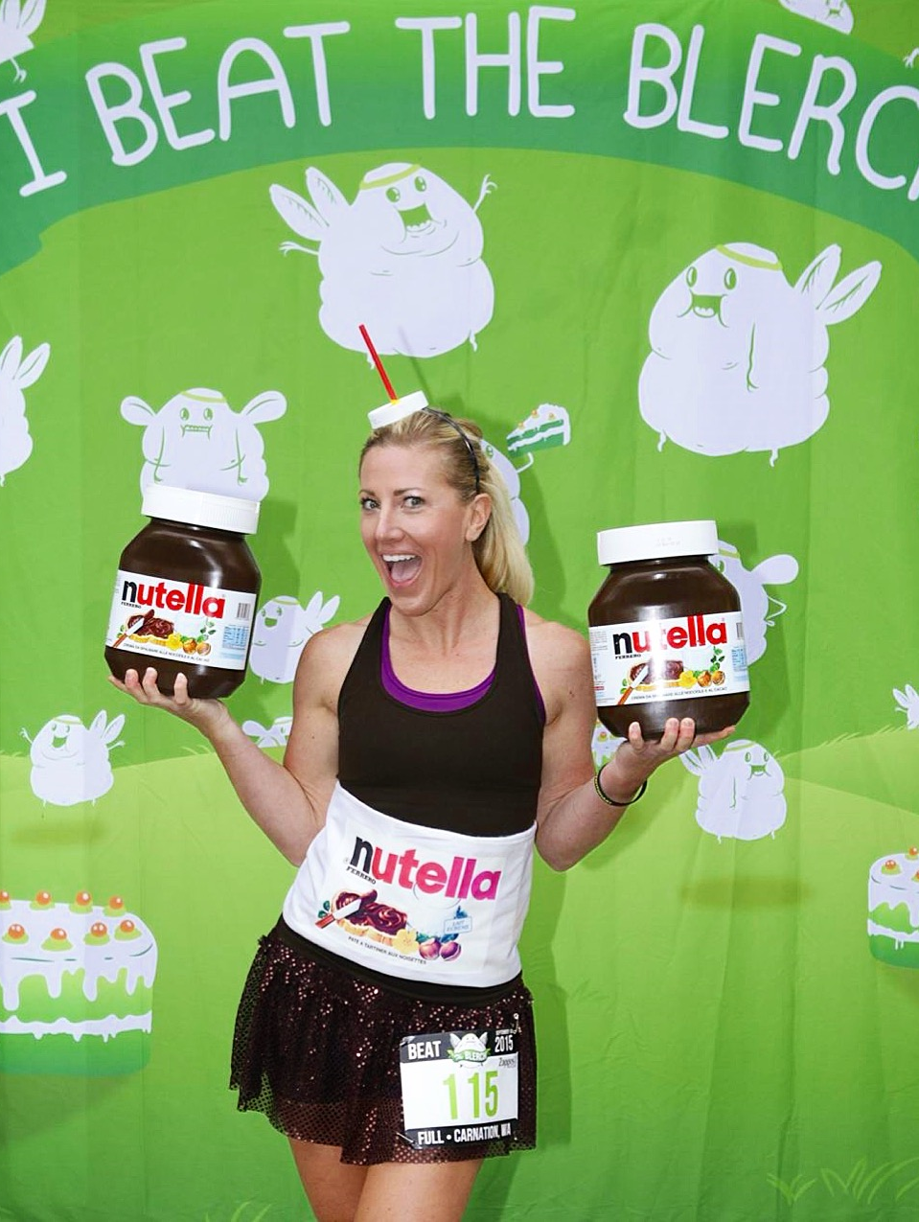
“Makes races more fun and enjoyable, leading up to the race, putting together a costume is all part of the experience. At the races, I pay close attention to what others are wearing for inspiration as to how I can make my own costumes better. It's a fun process. I love hunting for accessories and also crafting.”
--
“ (I just) Buy a tree skirt, turn it into a me skirt.”
--
“We picked characters and I went and hunted down pieces for everyone because I enjoy that part almost as much as wearing them”

Slide 20
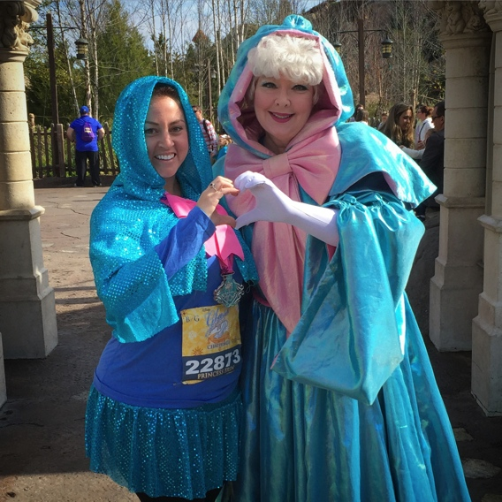
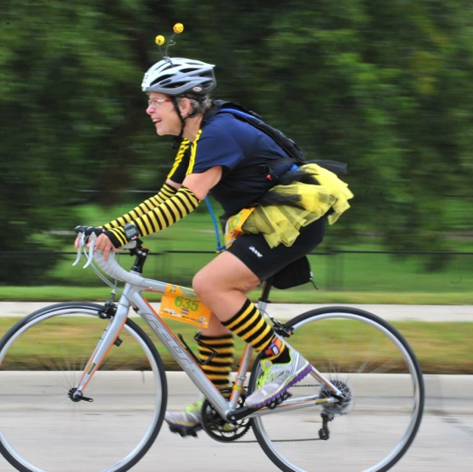
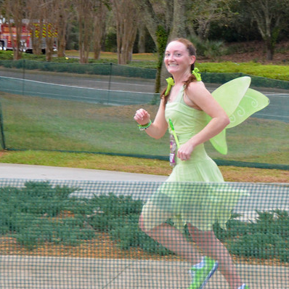
Recognition and Acknowledgement

Slide 21
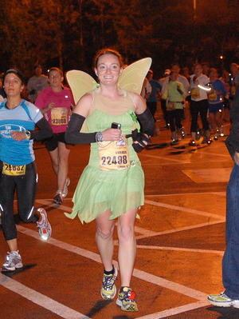
“BUT I wanted someone to look at me and know what the costume was”
--
“recognizability - people need to be able to tell who I am
--
“…hopefully wearing something that people recognize”
--
“It's fun-people cheer your costume name.”

Slide 22
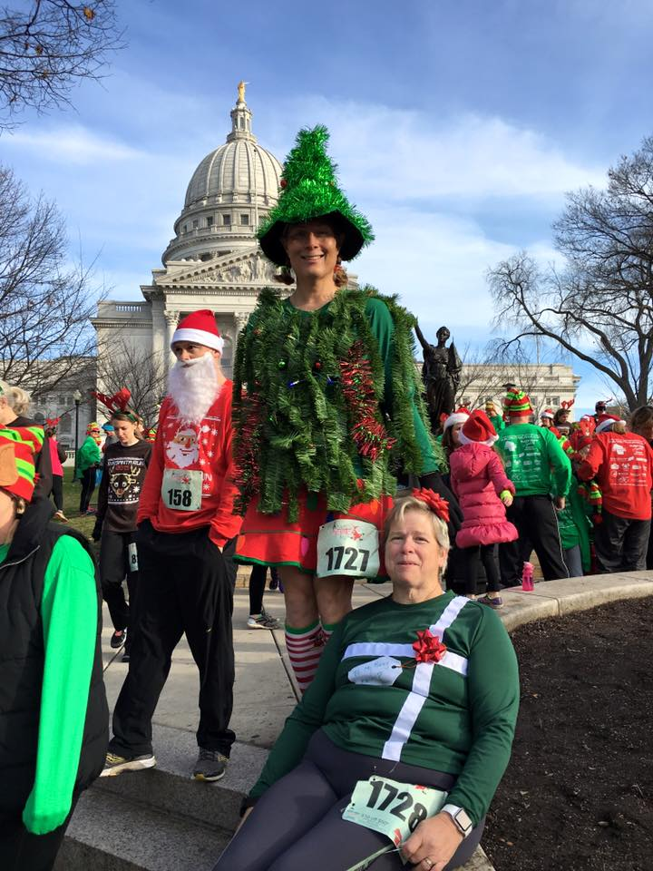
“It's mostly about recognition. That sounds worse now that I'm typing it out.”
--
“One of my favorite things about running in a costume is when the spectators and fellow runners tell you they like your costume”
--
“…and the attention that other runners give you feels good.”

Slide 23


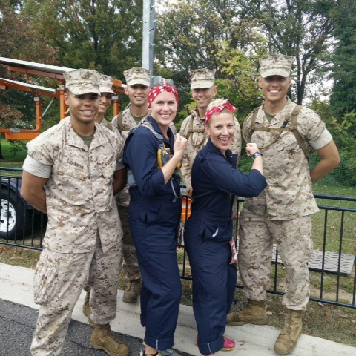
Other Social Aspects

Slide 24
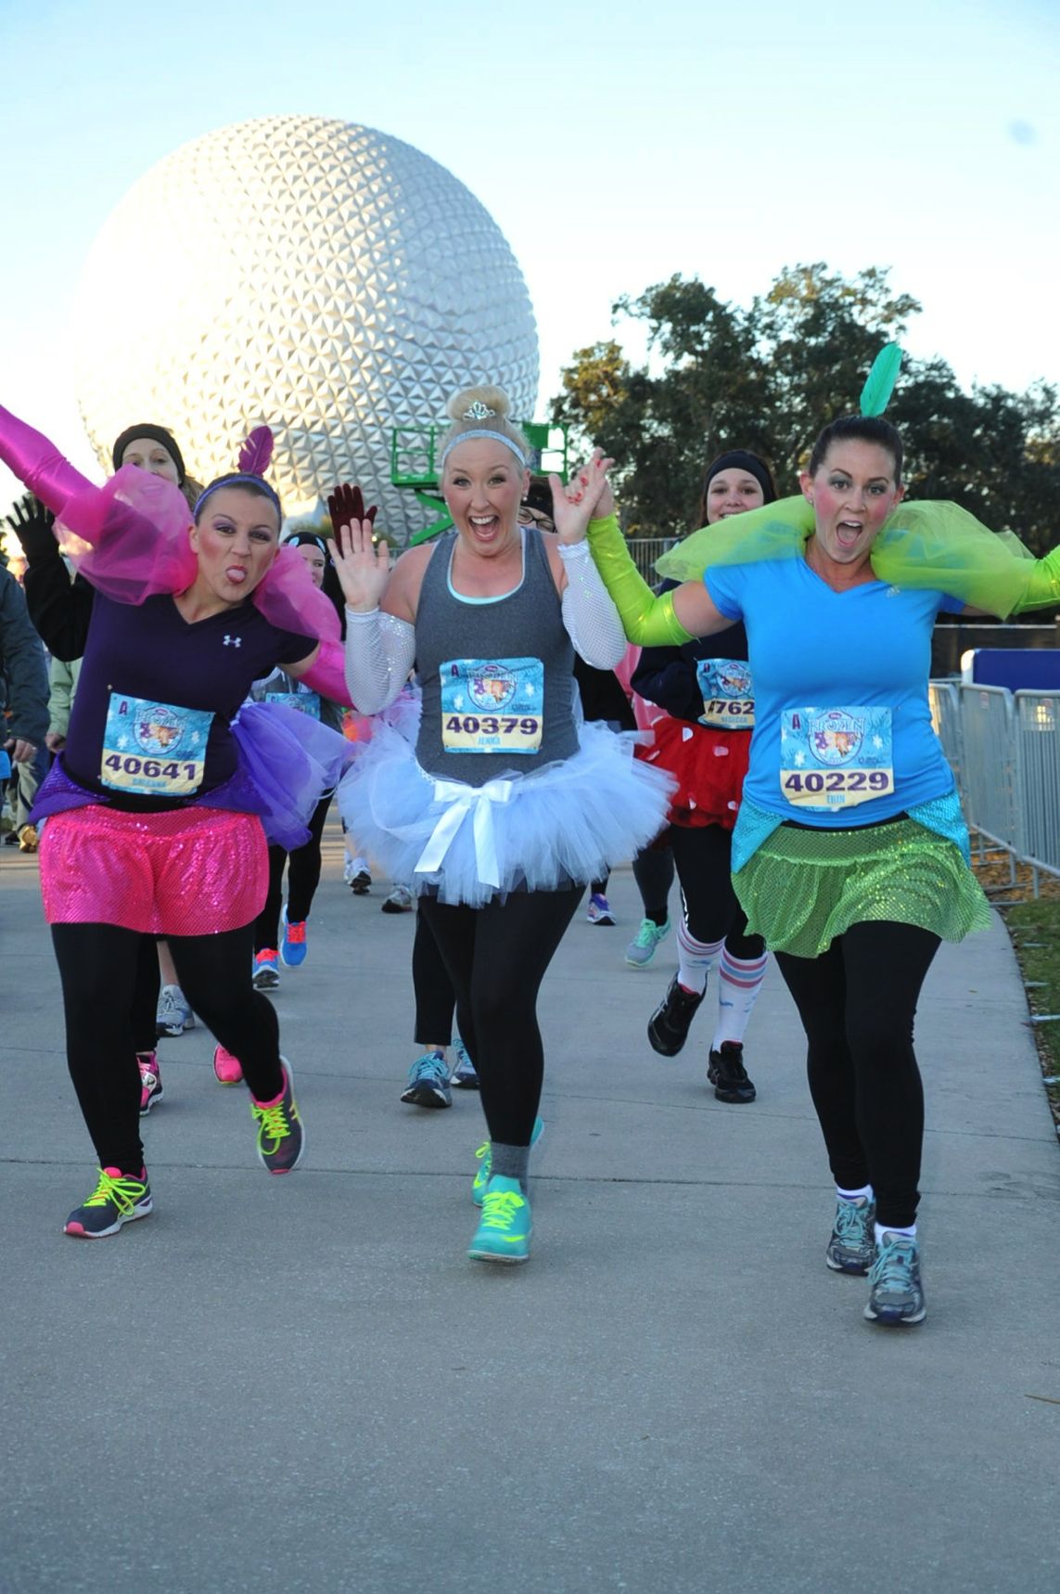
“I’ve met so many great people that I may not have met had I not been in costume. “
--
“It's also a fun way to meet people during the race other runners complement each other and motivate each other. It has always been a great experience”
--
You met new people waiting for the race because it makes you approachable

Slide 25
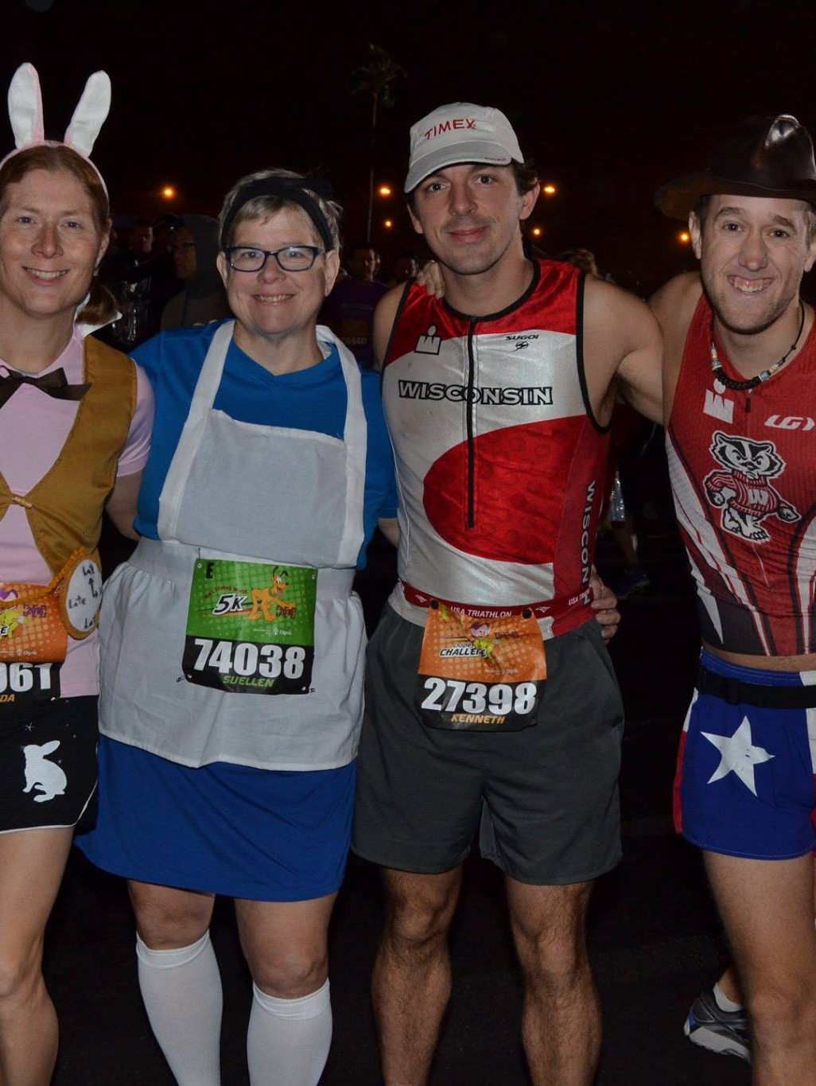
“there’s a non-race aspect; just like with cosplay, while I can’t get to see everything “in person”, costuming runners have also formed on-line networks (as you know). That “virtual” interaction, that virtual exchange, is also important positive aspect. Earning that respect within a virtual community of people you admire can be a positive reinforcement just like interacting at the actual races.”
--
“For someone who is not an elite runner it makes running fun. My friends and family look forward to what I am going to wear each time I announce a race.”

Slide 26
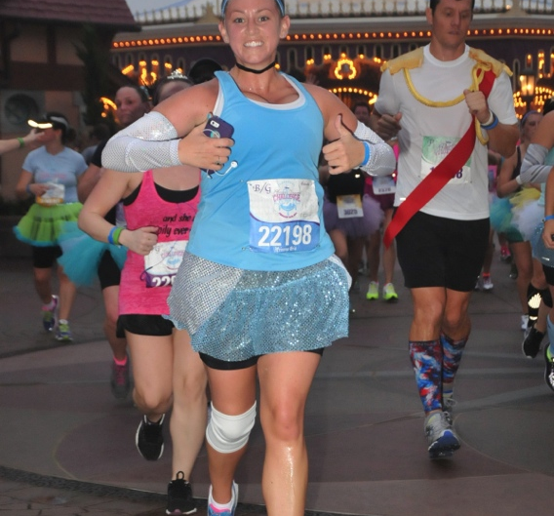
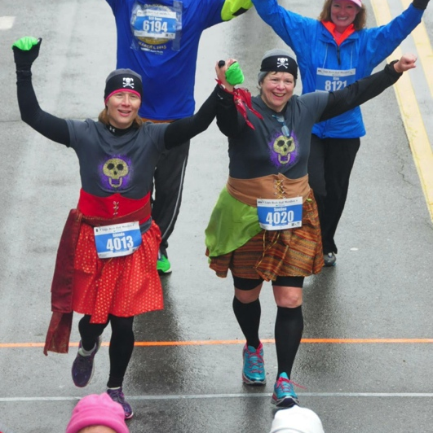

Motivation

Slide 27
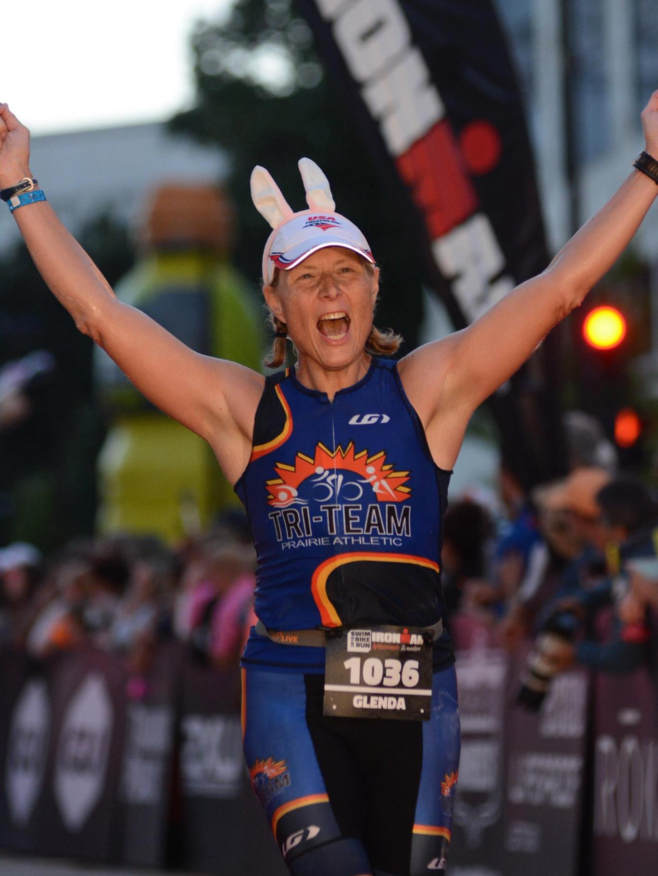
“What I love most about the running community is the positive energy. I’ve been told that I made people smile and gave them the energy that they needed, right when they needed it. In return, I feed off of those smiles and it gives me the energy when I’m hitting my wall as well”
--
“I knew that in that point in the race I would be exhausted and verging on emotional collapse. I knew that putting a clown suit on would make it hard to be serious and it made me and everyone else laugh”

Slide 28
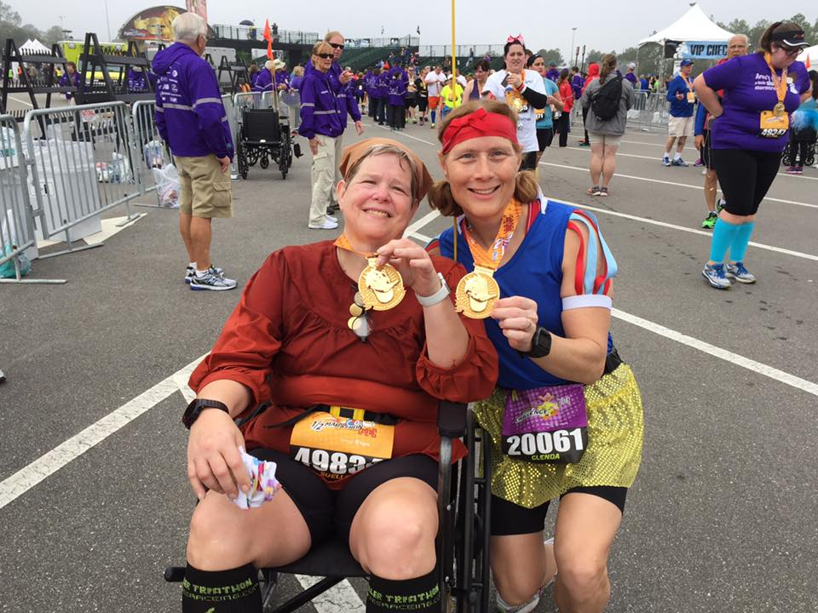
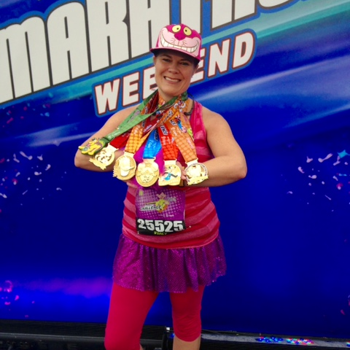
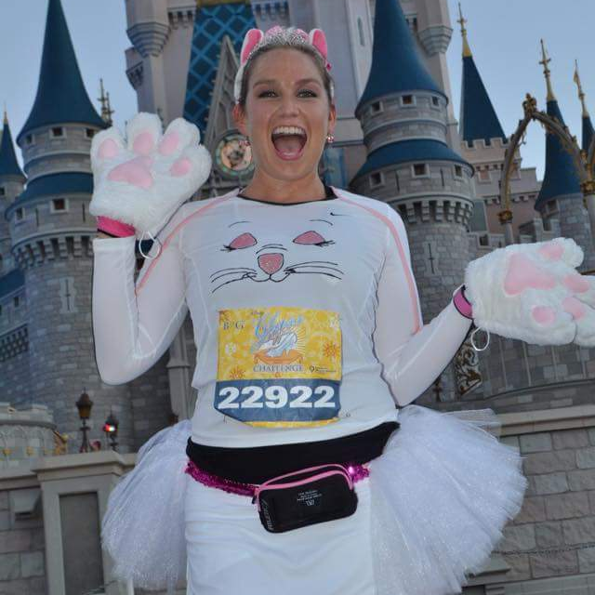
Questions?

